Slide 1
Distributed and Cloud Computing
K. Hwang, G. Fox and J. Dongarra
Chapter 6: Cloud Programming
and Software Environments
Part 1
Adapted from Kai Hwang, University of Southern California
with additions from
Matei Zaharia, EECS, UC Berkeley
November 25, 2012

Slide 2
Parallel Computing and Programming Enviroments
MapReduce
Hadoop
Amazon Web Services
DataBricks

Slide 3
What is MapReduce?
Simple data-parallel programming model
For large-scale data processing
  Exploits large set of commodity computers
  Executes process in distributed manner
  Offers high availability
Pioneered by Google
  Processes 20 petabytes of data per day
Popularized by open-source Hadoop project
  Used at Yahoo!, Facebook, Amazon, …

Slide 4
What is MapReduce used for?
At Google:
  Index construction for Google Search
  Article clustering for Google News
  Statistical machine translation
At Yahoo!:
  “Web map” powering Yahoo! Search
  Spam detection for Yahoo! Mail
At Facebook:
  Data mining
  Ad optimization
  Spam detection

Slide 5
Motivation: Large Scale Data Processing
Many tasks composed of processing lots of data to produce lots of other data
Want to use hundreds or thousands of CPUs
... but this needs to be easy!
MapReduce provides
  User-defined functions
  Automatic parallelization and distribution
  Fault-tolerance
  I/O scheduling
  Status and monitoring

Slide 6
What is MapReduce used for?
In research:
  Astronomical image analysis (Washington)
  Bioinformatics (Maryland)
  Analyzing Wikipedia conflicts (PARC)
  Natural language processing (CMU)
  Particle physics (Nebraska)
  Ocean climate simulation (Washington)
  <Your application here>

Slide 7
Distributed Grep
Split data
grep
matches
Split data
grep
matches
Very
big
data
All
matches
Split data
grep
matches
cat
Split data
grep
matches
grep is a command-line utility for searching plain-text data sets for lines matching a regular expression.
cat is a standard Unix utility that concatenates and lists files

Slide 8
Distributed Word Count
Split data
count
count
Split data
count
count
Very
big
data
merged
count
Split data
count
count
merge
Split data
count
count

Slide 9
Map+Reduce
Map:
  Accepts input key/value pair
  Emits intermediate key/value pair
Reduce :
  Accepts intermediate key/value* pair
  Emits output key/value pair
R
E
D
U
C
E
Very
big
data
M
A
P
Partitioning
Function
Result

Slide 10
Architecture overview
Master node
user
Job tracker
Slave node 1
Slave node 2
Slave node N
Task tracker
Task tracker
Task tracker
Workers
Workers
Workers

Slide 11
GFS: underlying storage system
Goal
  global view
  make huge files available in the face of node failures
Master Node (meta server)
  Centralized, index all chunks on data servers
Chunk server (data server)
  File is split into contiguous chunks, typically 16-64MB.
  Each chunk replicated (usually 2x or 3x).
    Try to keep replicas in different racks.

Slide 12
GFS architecture
GFS Master
Client
C₀
C₁
C₁
C₀
C₅
…
C₅
Chunkserver 1
Chunkserver 2
Chunkserver N
C₂
C₅
C₃
C₂

Slide 13
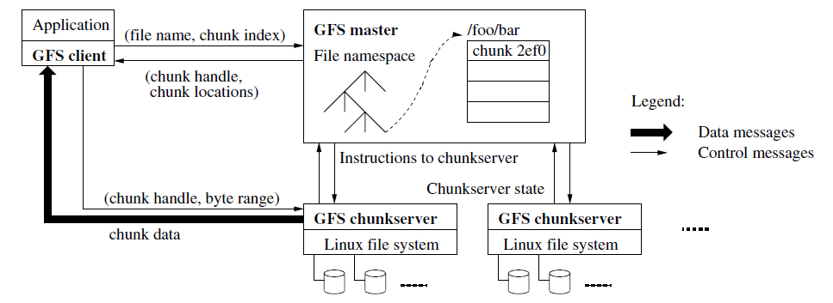
Classical Big Data:
Google File System Architecture

Slide 14
Functions in the Model
Map
  Process a key/value pair to generate intermediate key/value pairs
Reduce
  Merge all intermediate values associated with the same key
Partition
  By default : hash(key) mod R
  Well balanced

Slide 15
Programming Concept
Map
  Perform a function on individual values in a data set to create a new list of values
  Example: square x = x * x
  map square [1,2,3,4,5]
  returns [1,4,9,16,25]
Reduce
  Combine values in a data set to create a new value
  Example: sum = (each elem in arr, total +=)
  reduce [1,2,3,4,5]
  returns 15 (the sum of the elements)‏

Slide 16
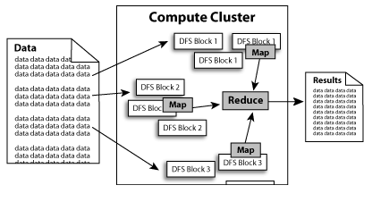

Slide 17
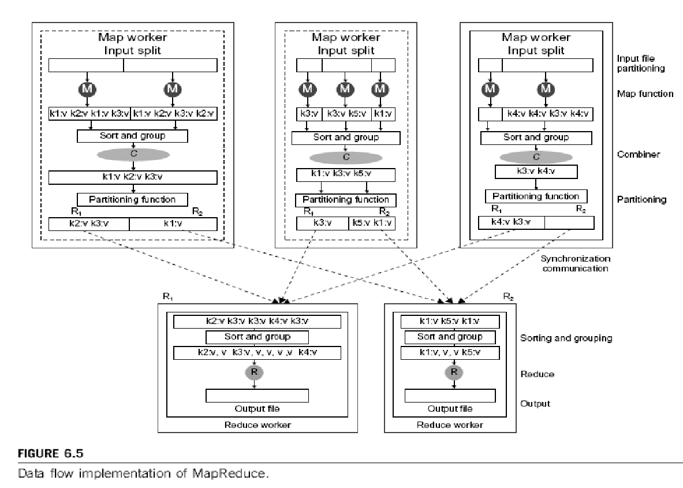
Notes:
Cloud applications are the key global opportunity for developers during next four years
2009: $8.5 billion
2013: $16.8 billion

Slide 18
A Simple Example
Counting words in a large set of documents
map(string value)‏
  //key: document name
  //value: document contents
  for each word w in value
    EmitIntermediate(w, “1”);
reduce(string key, iterator values)‏
  //key: word
  //values: list of counts
  int results = 0;
  for each v in values
    result += ParseInt(v);
  Emit(AsString(result));
The map function emits each word w plus an associated count of occurrences (just a “1” is recorded in this
pseudo-code)
The reduce function sums together all counts emitted for a particular word

Slide 19
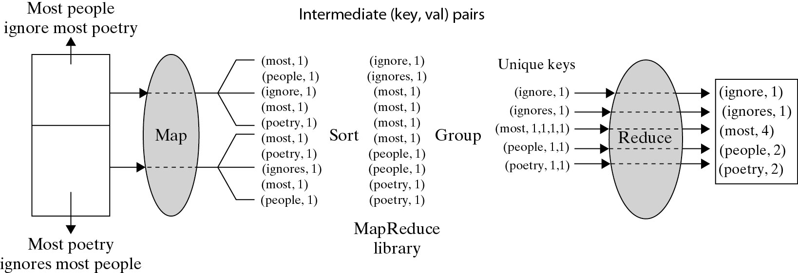
A Word Counting Example on <Key, Count> Distribution
Notes:
Cloud applications are the key global opportunity for developers during next four years
2009: $8.5 billion
2013: $16.8 billion

Slide 20
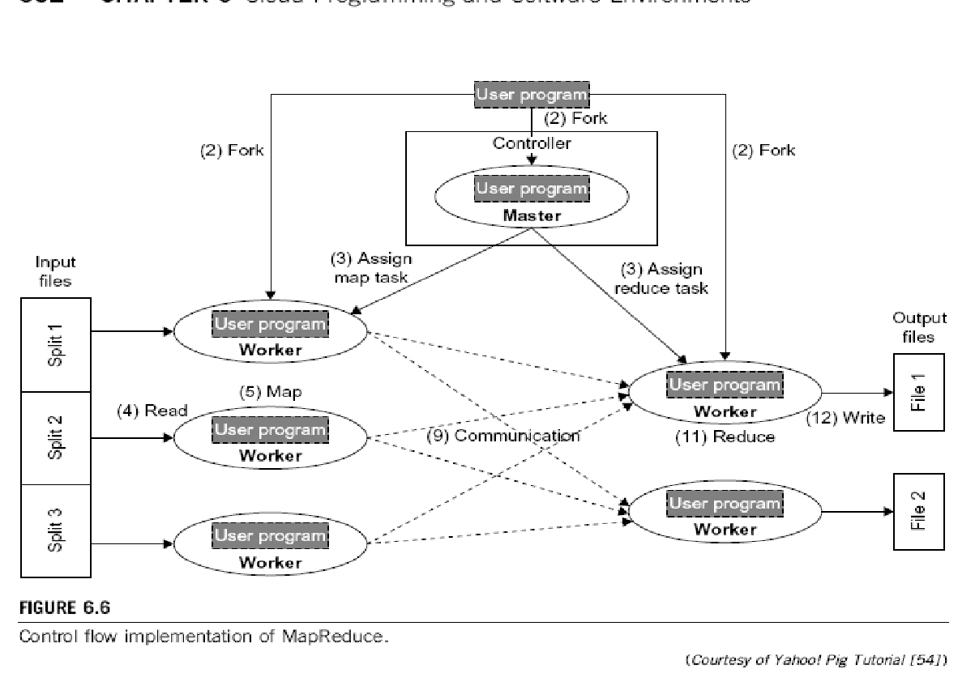
How Does it work?
Map invocations are distributed across multiple machines by automatically partitioning the input data into a set of M splits.
Reduce invocations are distributed by paritioning the intermediate key space into R pieces using a hash function: hash(key) mod R.
  R and the partitioning function are specified by the programmer.
Notes:
Cloud applications are the key global opportunity for developers during next four years
2009: $8.5 billion
2013: $16.8 billion

Slide 21
MapReduce : Operation Steps
When the user program calls the MapReduce function, the following sequence of actions occurs :
1) The MapReduce library in the user program first splits the input files into M pieces – 16 megabytes to 64 megabytes (MB) per piece. It then starts up many copies of program on a cluster of machines.
2) One of the copies of program is master. The rest are workers that are assigned work by the master.

Slide 22
MapReduce : Operation Steps
3) A worker who is assigned a map task :
  reads the contents of the corresponding input split
  parses key/value pairs out of the input data and passes each pair to the user - defined Map function.
The intermediate key/value pairs produced by the Map function are buffered in memory.
4) The buffered pairs are written to local disk, partitioned into R regions by the partitioning function.
The location of these buffered pairs on the local disk are passed back to the master, who forwards these locations to the reduce workers.

Slide 23
MapReduce : Operation Steps
5) When a reduce worker is notified by the master about these locations, it reads the buffered data from the local disks of the map workers.
When a reduce worker has read all intermediate data, it sorts it by the intermediate keys so that all occurrences of the same key are grouped together.
6) The reduce worker iterates over the sorted intermediate data and for each unique intermediate key, it passes the key and the corresponding set of intermediate values to the user’s Reduce function.
The output of the Reduce function is appended to a final output file.

Slide 24
MapReduce : Operation Steps
7) When all map tasks and reduce tasks have been completed, the master wakes up the user program.
At this point, MapReduce call in the user program returns back to the user code.
After successful completion, output of the mapreduce execution is available in the R output files.

Slide 25
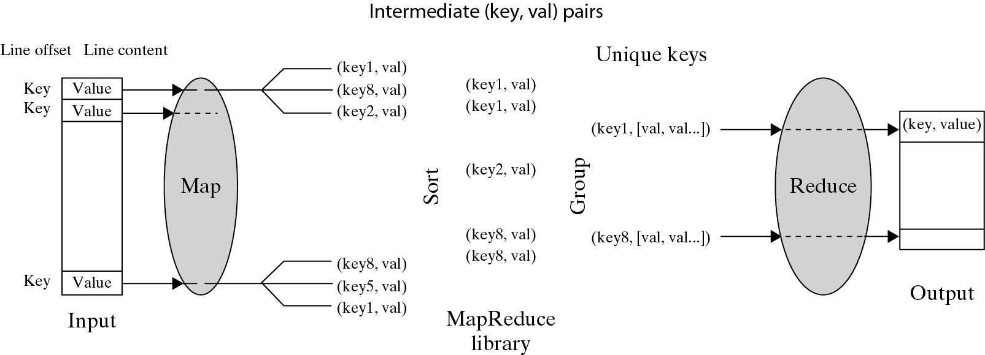
Logical Data Flow in 5 Processing
Steps in MapReduce Process
(Key, Value) Pairs are generated by the Map function over multiple available Map Workers (VM instances). These pairs are then sorted and group based on key ordering. Different key-groups are then processed by multiple Reduce Workers in parallel.
Notes:
Cloud applications are the key global opportunity for developers during next four years
2009: $8.5 billion
2013: $16.8 billion

Slide 26
Locality issue
Master scheduling policy
  Asks GFS for locations of replicas of input file blocks
  Map tasks typically split into 64MB (== GFS block size)
  Map tasks scheduled so GFS input block replica are on same machine or same rack
Effect
  Thousands of machines read input at local disk speed
  Without this, rack switches limit read rate

Slide 27
Fault Tolerance
Reactive way
  Worker failure
    Heartbeat, Workers are periodically pinged by master
      NO response = failed worker
    If the processor of a worker fails, the tasks of that worker are reassigned to another worker.
  Master failure
    Master writes periodic checkpoints
    Another master can be started from the last checkpointed state
    If eventually the master dies, the job will be aborted

Slide 28
Fault Tolerance
Proactive way (Redundant Execution)
  The problem of “stragglers” (slow workers)
    Other jobs consuming resources on machine
    Bad disks with soft errors transfer data very slowly
    Weird things: processor caches disabled (!!)
  When computation almost done, reschedule in-progress tasks
  Whenever either the primary or the backup executions finishes, mark it as completed

Slide 29
Fault Tolerance
Input error: bad records
  Map/Reduce functions sometimes fail for particular inputs
  Best solution is to debug & fix, but not always possible
  On segment fault
    Send UDP (User Datagram Protocol) packet to master from signal handler
    Include sequence number of record being processed
  Skip bad records
    If master sees two failures for same record, next worker is told to skip the record

Slide 30
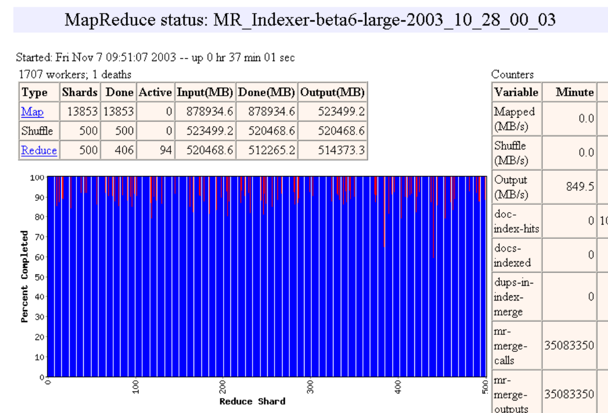
Status monitor

Slide 31
Points need to be emphasized
No reduce can begin until map is complete
Master must communicate locations of intermediate files
Tasks scheduled based on location of data
If map worker fails any time before reduce finishes, task must be completely rerun
MapReduce library does most of the hard work for us!

Slide 32
Other Examples
Distributed Grep:
  Map function emits a line if it matches a supplied pattern.
  Reduce function is an identity function that copies the supplied intermediate data to the output.
Count of URL accesses:
  Map function processes logs of web page requests and outputs <URL, 1>,
  Reduce function adds together all values for the same URL, emitting <URL, total count> pairs.
Reverse Web-Link graph; e.g., all URLs with reference to http://dblab.usc.edu:
  Map function outputs <tgt, src> for each link to a tgt in a page named src,
  Reduce concatenates the list of all src URLS associated with a given tgt URL and emits the pair: <tgt, list(src)>.
Inverted Index; e.g., all URLs with 585 as a word:
  Map function parses each document, emitting a sequence of <word, doc_ID>,
  Reduce accepts all pairs for a given word, sorts the corresponding doc_IDs and emits a <word, list(doc_ID)> pair.
  Set of all output pairs forms a simple inverted index.

Slide 33



MapReduce Implementations
MapReduce
Cluster,
1, Google
2, Apache Hadoop
Multicore CPU,
Phoenix @ stanford
GPU,
Mars@HKUST

Slide 34
Hadoop : software platform originally developed by Yahoo enabling users to write and run applications over vast distributed data.
Attractive Features in Hadoop :
Scalable : can easily scale to store and process petabytes of
data in the Web space
Economical : An open-source MapReduce minimizes the
overheads in task spawning and massive data communication.
Efficient: Processing data with high-degree of parallelism
across a large number of commodity nodes
Reliable : Automatically maintains multiple copies of data to
facilitate redeployment of computing tasks on failures

Slide 35
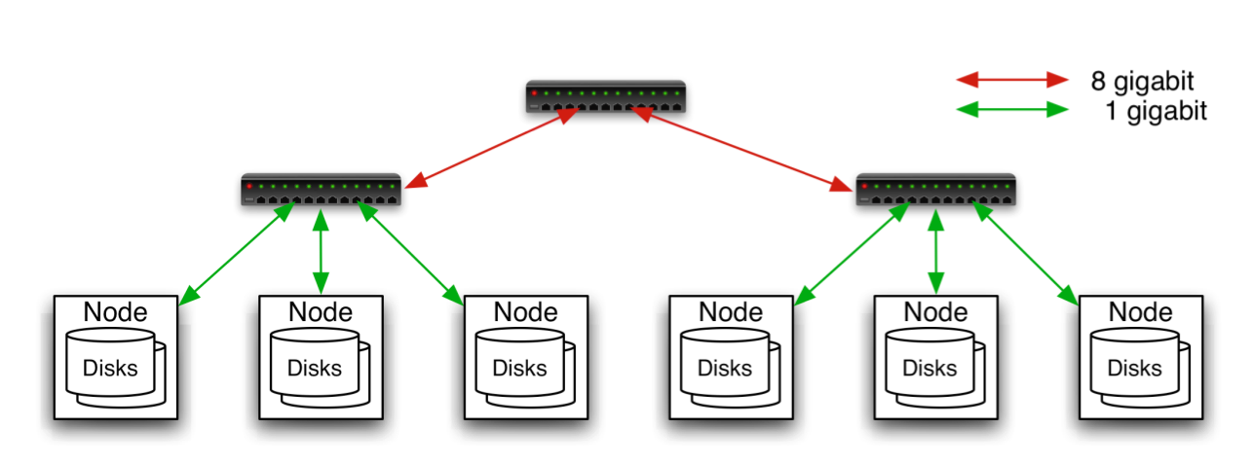
Typical Hadoop Cluster
Aggregation switch
Rack switch
40 nodes/rack, 1000-4000 nodes in cluster
1 Gbps bandwidth within rack, 8 Gbps out of rack
Node specs (Yahoo terasort):
8 x 2GHz cores, 8 GB RAM, 4 disks (= 4 TB?)
Image from http://wiki.apache.org/hadoop-data/attachments/HadoopPresentations/attachments/YahooHadoopIntro-apachecon-us-2008.pdf

Slide 36

Typical Hadoop Cluster
Image from http://wiki.apache.org/hadoop-data/attachments/HadoopPresentations/attachments/aw-apachecon-eu-2009.pdf

Slide 37
Challenges
Cheap nodes fail, especially if you have many
  Mean time between failures for 1 node = 3 years
  Mean time between failures for 1000 nodes = 1 day
  Solution: Build fault-tolerance into system
Commodity network = low bandwidth
  Solution: Push computation to the data
Programming distributed systems is hard
  Solution: Data-parallel programming model: users write “map” & “reduce” functions, system distributes work and handles faults

Slide 38
Hadoop Components
Distributed file system (HDFS)
  Single namespace for entire cluster
  Replicates data 3x for fault-tolerance
MapReduce framework
  Executes user jobs specified as “map” and “reduce” functions
  Manages work distribution & fault-tolerance

Slide 39

Hadoop Distributed File System
Files split into 128MB blocks
Blocks replicated across several datanodes (usually 3)
Single namenode stores metadata (file names, block locations, etc)
Optimized for large files, sequential reads
Files are append-only
Namenode
File1
1
2
3
4
1
2
1
3
2
1
4
2
4
3
3
4
Datanodes

Slide 40
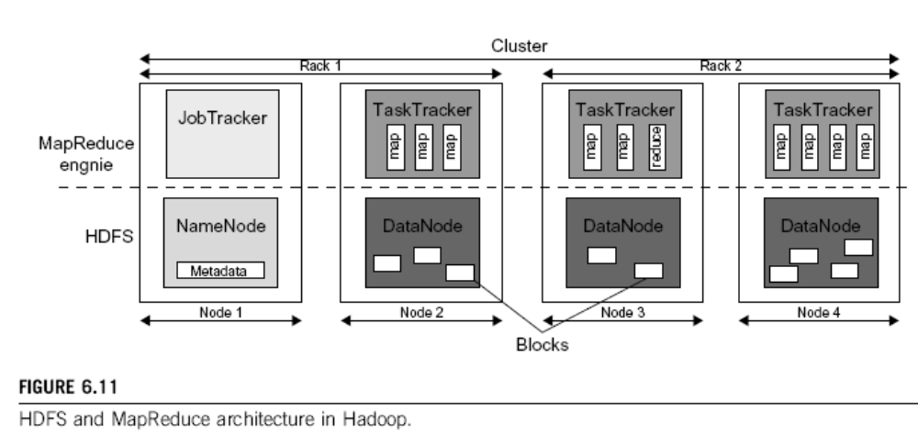
Notes:
Cloud applications are the key global opportunity for developers during next four years
2009: $8.5 billion
2013: $16.8 billion

Slide 41
Secure Query Processing with Hadoop/MapReduce
Query Rewriting and Optimization Principles defined and implemented for two types of data
(i) Relational data: Secure query processing with HIVE
(ii) RDF Data: Secure query processing with SPARQL
Demonstrated with XACML Policies (content, temporal, association)
Joint demonstration with Kings College and U. of Insubria
  First demo (2010): Each party submits their data and policies
  Our cloud will manage the data and policies
  Second demo (2011): Multiple clouds

Slide 42
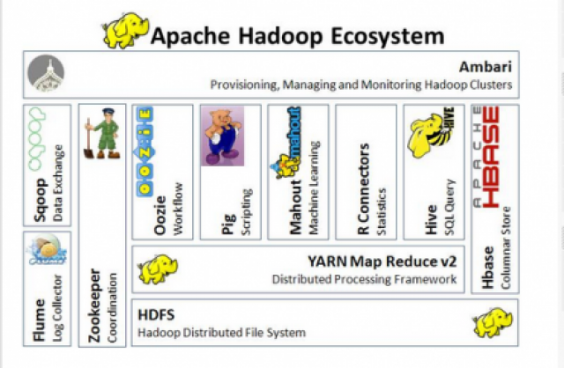

Slide 43
Higher-level languages over Hadoop: Pig and Hive

Slide 44
Motivation
Many parallel algorithms can be expressed by a series of MapReduce jobs
But MapReduce is fairly low-level: must think about keys, values, partitioning, etc
Can we capture common “job building blocks”?

Slide 45

Pig
Started at Yahoo! Research
Runs about 30% of Yahoo!’s jobs
Features:
  Expresses sequences of MapReduce jobs
  Data model: nested “bags” of items
  Provides relational (SQL) operators (JOIN, GROUP BY, etc)
  Easy to plug in Java functions
  Pig Pen development environment for Eclipse

Slide 46
An Example Problem
Load Users
Load Pages
Suppose you have user data in one file, page view data in another, and you need to find the top 5 most visited pages by users aged 18 - 25.
Filter by age
Join on name
Group on url
Count clicks
Order by clicks
Take top 5
Example from http://wiki.apache.org/pig-data/attachments/PigTalksPapers/attachments/ApacheConEurope09.ppt

Slide 47
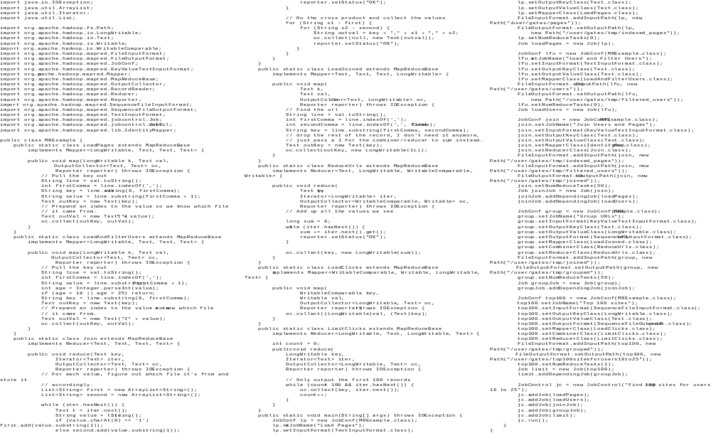
In MapReduce
Example from http://wiki.apache.org/pig-data/attachments/PigTalksPapers/attachments/ApacheConEurope09.ppt
Notes:
My point in putting in the java code isn’t too actually walk through it. It’s just to show that you have to hand code a fair amount of java. That way I can just point and say “look how much java you’d have to write to accomplish this”

Slide 48
In Pig Latin
Users = load ‘users’ as (name, age);
Filtered = filter Users by
age >= 18 and age <= 25;
Pages = load ‘pages’ as (user, url);
Joined = join Filtered by name, Pages by user;
Grouped = group Joined by url;
Summed = foreach Grouped generate group,
count(Joined) as clicks;
Sorted = order Summed by clicks desc;
Top5 = limit Sorted 5;
store Top5 into ‘top5sites’;
Example from http://wiki.apache.org/pig-data/attachments/PigTalksPapers/attachments/ApacheConEurope09.ppt
Notes:
Rather than using capital letters, which makes Pig Latin look like SQL, I added Eclipse style highlighting instead. Hopefully this makes clear what are the key words without making it look like a Matisse painting.

Slide 49
Ease of Translation
Notice how naturally the components of the job translate into Pig Latin.
Load Users
Load Pages
Users = load …
Filtered = filter …
Pages = load …
Joined = join …
Grouped = group …
Summed = … count()…
Sorted = order …
Top5 = limit …
Filter by age
Join on name
Group on url
Count clicks
Order by clicks
Take top 5
Example from http://wiki.apache.org/pig-data/attachments/PigTalksPapers/attachments/ApacheConEurope09.ppt
Notes:
No need to think about how many map reduce jobs this decomposes into, or connecting data flows between map reduces jobs, or even that this is taking place on top of map reduce at all.

Slide 50
Ease of Translation
Notice how naturally the components of the job translate into Pig Latin.
Load Users
Load Pages
Users = load …
Filtered = filter …
Pages = load …
Joined = join …
Grouped = group …
Summed = … count()…
Sorted = order …
Top5 = limit …
Filter by age
Join on name
Job 1
Group on url
Job 2
Count clicks
Order by clicks
Job 3
Take top 5
Example from http://wiki.apache.org/pig-data/attachments/PigTalksPapers/attachments/ApacheConEurope09.ppt
Notes:
No need to think about how many map reduce jobs this decomposes into, or connecting data flows between map reduces jobs, or even that this is taking place on top of map reduce at all.

Slide 51

Hive
Developed at Facebook
Used for majority of Facebook jobs
“Relational database” built on Hadoop
  Maintains list of table schemas
  SQL-like query language (HQL)
  Can call Hadoop Streaming scripts from HQL
  Supports table partitioning, clustering, complex
  data types, some optimizations

Slide 52
Sample Hive Queries
Find top 5 pages visited by users aged 18-25:
SELECT p.url, COUNT(1) as clicks
FROM users u JOIN page_views p ON (u.name = p.user)
WHERE u.age >= 18 AND u.age <= 25
GROUP BY p.url
ORDER BY clicks
LIMIT 5;
Filter page views through Python script:
SELECT TRANSFORM(p.user, p.date)
USING 'map_script.py'
AS dt, uid CLUSTER BY dt
FROM page_views p;

Slide 53
Amazon Elastic MapReduce
Provides a web-based interface and command-line tools for running Hadoop jobs on Amazon EC2
Data stored in Amazon S3
Monitors job and shuts down machines after use
Small extra charge on top of EC2 pricing
If you want more control over how you Hadoop runs, you can launch a Hadoop cluster on EC2 manually using the scripts in src/contrib/ec2

Slide 54
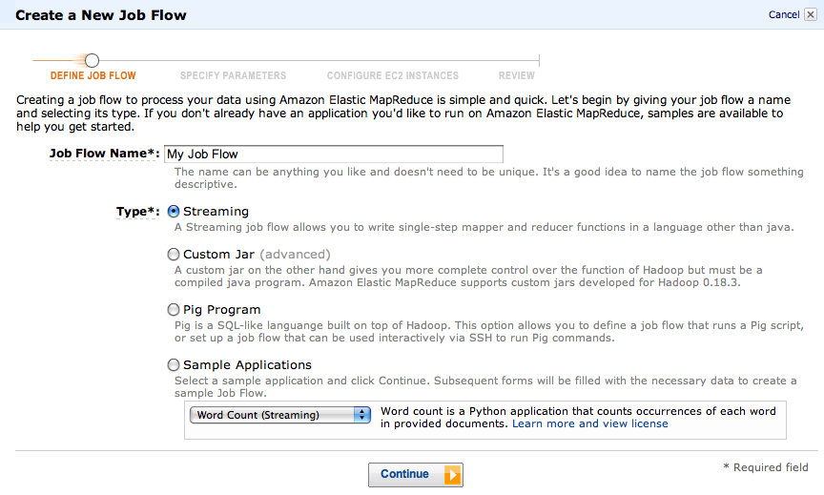
Elastic MapReduce Workflow

Slide 55
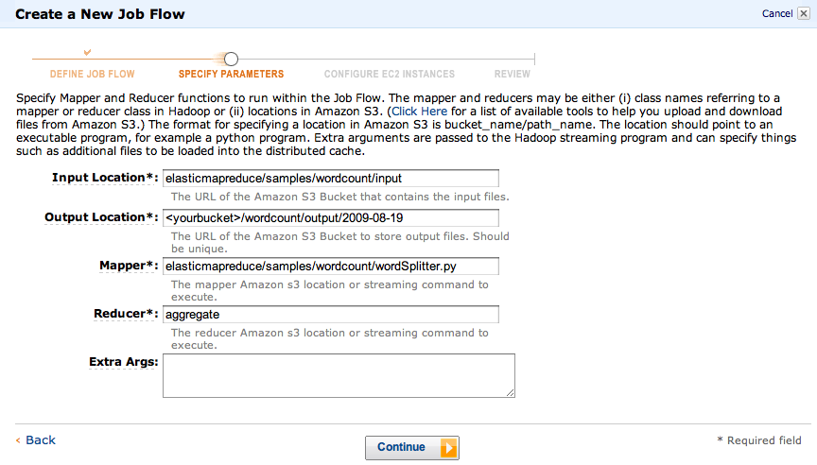
Elastic MapReduce Workflow

Slide 56
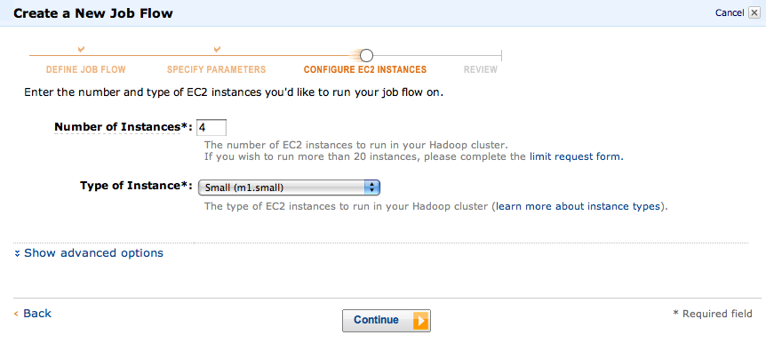
Elastic MapReduce Workflow

Slide 57
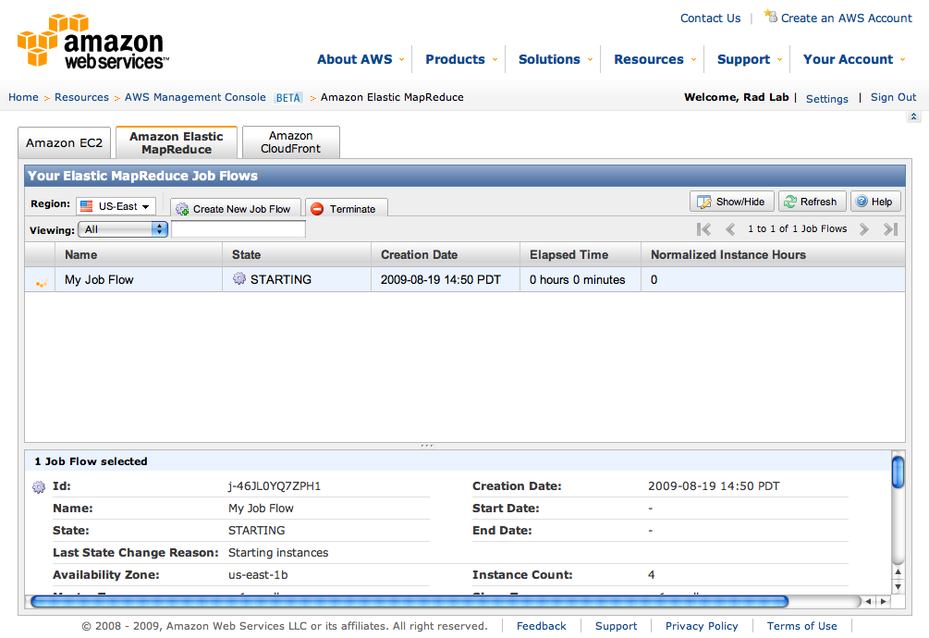
Elastic MapReduce Workflow

Slide 58
Conclusions
MapReduce programming model hides the complexity of work distribution and fault tolerance
Principal design philosophies:
  Make it scalable, so you can throw hardware at problems
  Make it cheap, lowering hardware, programming and admin costs
MapReduce is not suitable for all problems, but when it works, it may save you quite a bit of time
Cloud computing makes it straightforward to start using Hadoop (or other parallel software) at scale

Slide 59
Resources
Hadoop: http://hadoop.apache.org/core/
Pig: http://hadoop.apache.org/pig
Hive: http://hadoop.apache.org/hive
Video tutorials: http://www.cloudera.com/hadoop-training
Amazon Web Services: http://aws.amazon.com/
Amazon Elastic MapReduce guide:
http://docs.amazonwebservices.com/ElasticMapReduce/latest/GettingStartedGuide/

